Slide 1

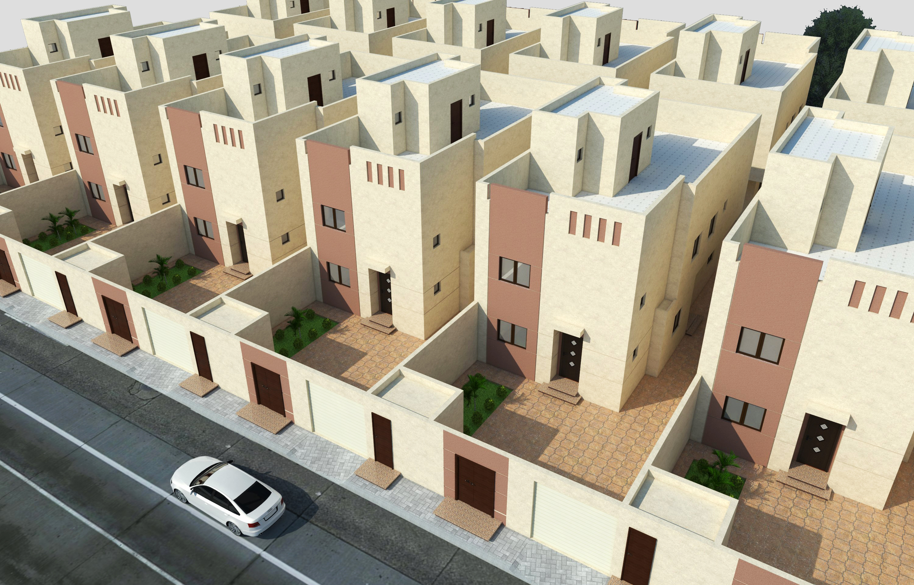
Apartments for Sale-Real Estate Market in Riyadh
Here is where your presentation begins
Group Name: Homeowners

Slide 2
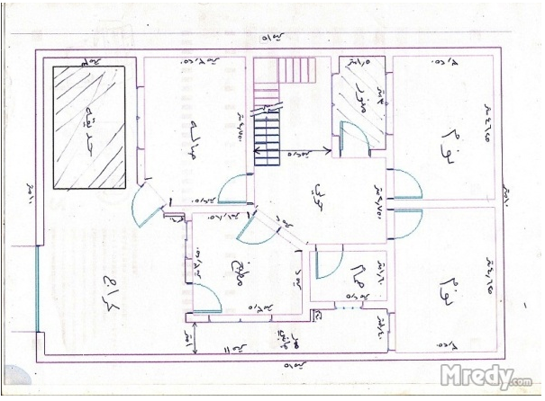
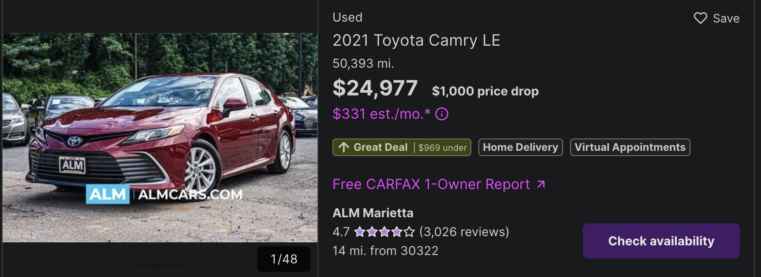
Introduction
1) Provide home-buyers with tools that help them better understand the target market (apartments for sale in Riyadh) and 2), get an estimate of how fair the asking price is for an apartment
Goal: Develop an analytical dashboard and create a “Good Deal Indicator” feature.
Community Engagement: Contribute a clean dataset on Kaggle
Notes:
Question: can we add value to the real estate market in Saudi Arabia by helping home buyers make better purchases?
Hope:
1- better understand the market
2- estimate the price of apartments accuratly
Goal:
1- develop an analytical dashboard
2- Create a ”Good Deal Indicator” (talk about the car picture)

Slide 3
1
2
3
4
Machine Learning model
5
“Good Deal Indicator”
OUTLINES
Data Dictionary
Data Web Scraping
Data Cleaning
6
Analytical Dashboard
CONCLUSION
7

Slide 4
DATASET
Features | Description
user_id | The ad poster’s Aqar ID
id | A unique value for each ad
price | Sale value in SR
beds | Number of bedrooms
livings | Number of living rooms
wc | Number of bathrooms
area | In sq. meters
street_width | Of the apartment complex, in meters
age | In years
street_direction | Of the apartment complex, (e.g., north-south, east-west)

Slide 5
DATASET
Features | Description
ketchen | {0, 1}
furnished | {0, 1}
district | The name of the district in Arabic
width | In meters
length | In meters
advertiser_type | {‘owner’, ‘exclusive_advertiser’, etc}
city_side | {‘north’, ‘south’, etc}
district_en | The name of the district in English
time_on_market | Number of days since post date until today
time_since_update | Number of days since the post was last updated

Slide 6
DATASET
Features | Description
last_update | Four features: year, month, day, hour
create_time | Four features: year, month, day, hour
latitude | Latitude coordinate of apartment complex
longitude | Longitde coordinate of apartment complex
squareness | Does the apartment look more like a square or rectangle? The ratio of length to width
regular_shapeness | Is the apartment shape regular? The ratio of area to length * width

Slide 7
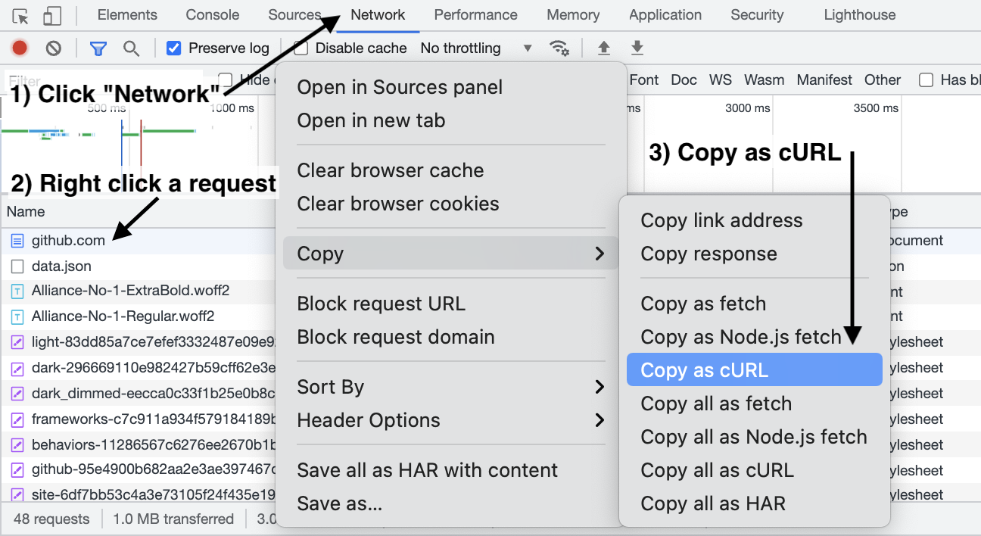
Data Web Scraping
1) Identify the relevant request
Notes:
1- The process of web scraping I had to follow is a little unusual due to aqar’s website peculiar website
2- Go to web browser and inspect the webpage you want to scrape
3- Find all the requests between your browser and the website
4- identify the request you are interested in
5- get the information of that request
6- make that request in python as many times as necessary

Slide 8
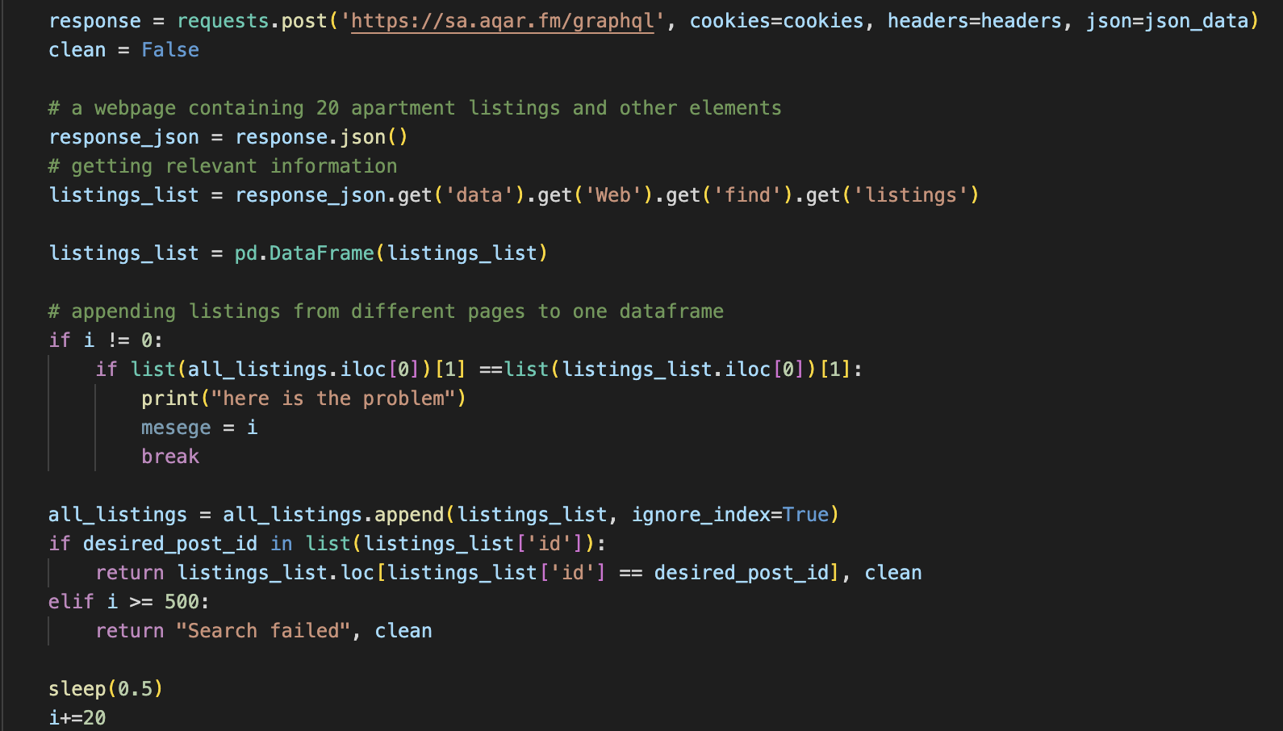
Data Web Scraping
2) Make a python request and save to csv file
Notes:
1- Make the request you see at the top over and over while updating the index you want to search
2- At every iteration concatinate a dataframe with 20 ads to your main dataframe
3- At end of this I had about 8000 instances

Slide 9
Data Cleaning
Drop Irrelevent features (e.g., desription, images)
Find the district’s name in English (using outside sources)
Create time features (change from integer to multiple informative features)
Extract coordinates (from a string)
Create experimental features (e.g., squareness)

Slide 10
Data Assumptions
Advertisers provide fair estimates of the price
We can estimate the price using only general information on the apartment
People agree on the definition of “living room”, “bed room” etc,.
Notes:
1- we don’t have information on how nice the flooring is, what the painting color is, is there an elevator, etc.,
2- I have found apartments with the same number of rooms with the same layout buy one calls the guest room a living room, and one calls them all as just rooms.

Slide 11
ML Model Development
Train-test-split: standard 70-30 split
Use pd.DataFrame.fillna() to encode all null values using one encoding (e.g., None, pd.NA, np.nan, etc.)
Normalize numeric features using yeo-johnson power transformation
Standarize numeric features using standard scaler
Normalize label (price) using box-cox power transformation
KNN Imputation

Slide 12
ML Models Trials
Linear regression:
RMSE: 0.93
Linear Regression with Elastic Net Regularization:
RMSE: 0.90
Hyper Tuned Decision Tree (best):
RMSE: 0.73

Slide 13
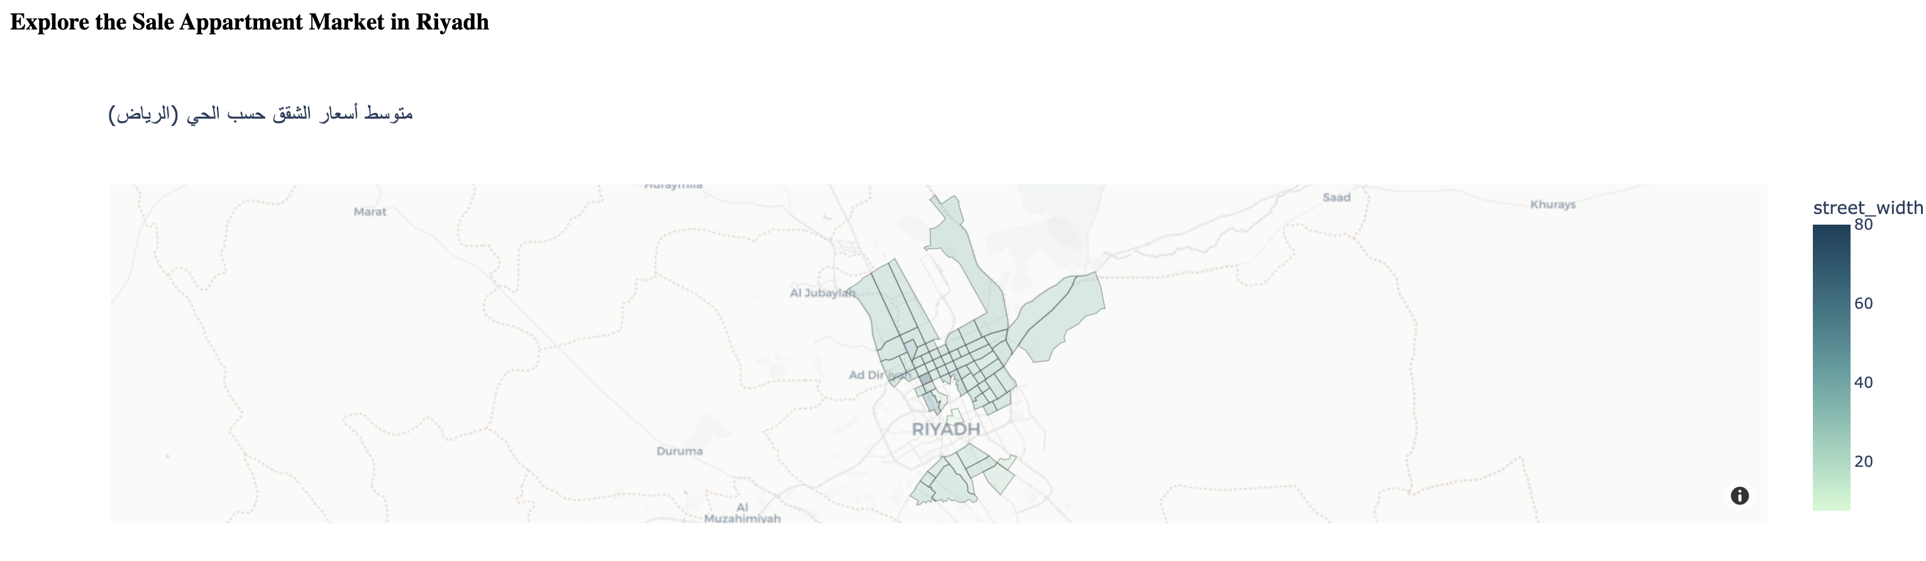
Good Deal Indicator
Search Aqar’s website for an ad with the specified id-scrape the data
Clean the data
Train an ML using a subset of our data (based on user’s specification)
Compare the model’s predicted_price and real_price
Report “deal_goodness” {Great Deal, Good Deal, Fair Deal, Poor Deal, Terrible Deal}
Goal: Help the home-buyer determine if an apartment they are interested in is fairly priced.
Required: ad_id
Communicate: Report results in analytical dash board

Slide 14
Challenges
Poor data quality
Adequetely accurate predictions, but need to be imporoved
Suggesting similar apartments to user’s-provided apartments
Difficulty interpreting RMSE

Slide 15
Take Home Message
Data availability and quality remain the biggest obstacles for data scientists in real estate
It is possible to add value to the real estate industry by helping home-buyers make better-informed decisions

Slide 16
Future Development
Improve data quality
Utilize text description of properties in making price predictions
Utilize images of properties to validate some features (e.g., furnished) and possibly more
Utilize Google Maps-like API to expand the features in the dataset to include things like: distance_to_major_highway, distance_to_grocery_store, avg_trafic_index, etc.

Slide 17
THANKS!
Any questions?
Mohammed Alsalamah

